Slide 1
Medical AI
Lee DongNyoung
Sohaib Abdullah
Pham Van Linh
GROUP 2

Slide 2
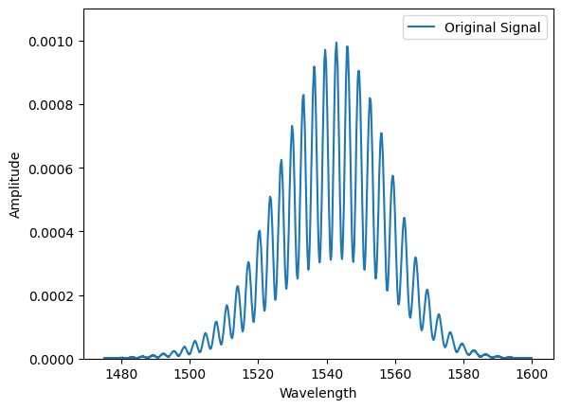
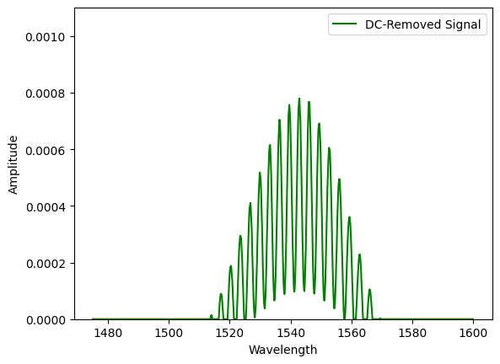
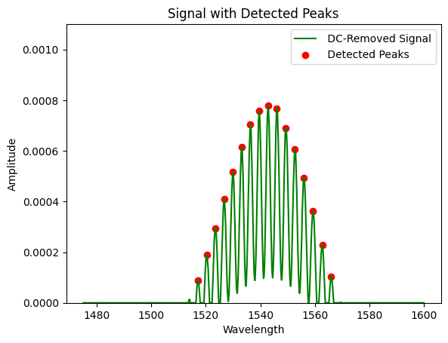
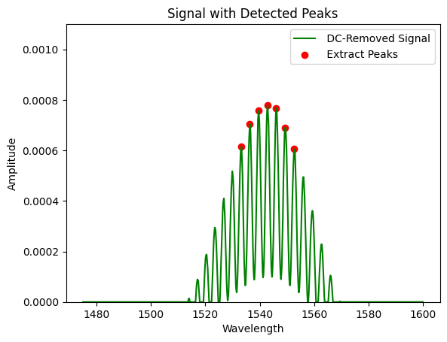
Features from single data
1
2
3
4

Slide 3

stack whole data
Single data
[x₁ x₂ x₃ x₄ x₅ y₁ y₂ y₃ y₄ y₅]
Whole data
[x₁ x₂ x₃ x₄ x₅ y₁ y₂ y₃ y₄ y₅] ₁
[x₁ x₂ x₃ x₄ x₅ y₁ y₂ y₃ y₄ y₅] ₂
………………………………
[x₁ x₂ x₃ x₄ x₅ y₁ y₂ y₃ y₄ y₅] ₂₅₀
[x₁ x₂ x₃ x₄ x₅ y₁ y₂ y₃ y₄ y₅] ₂₅₁

Slide 4
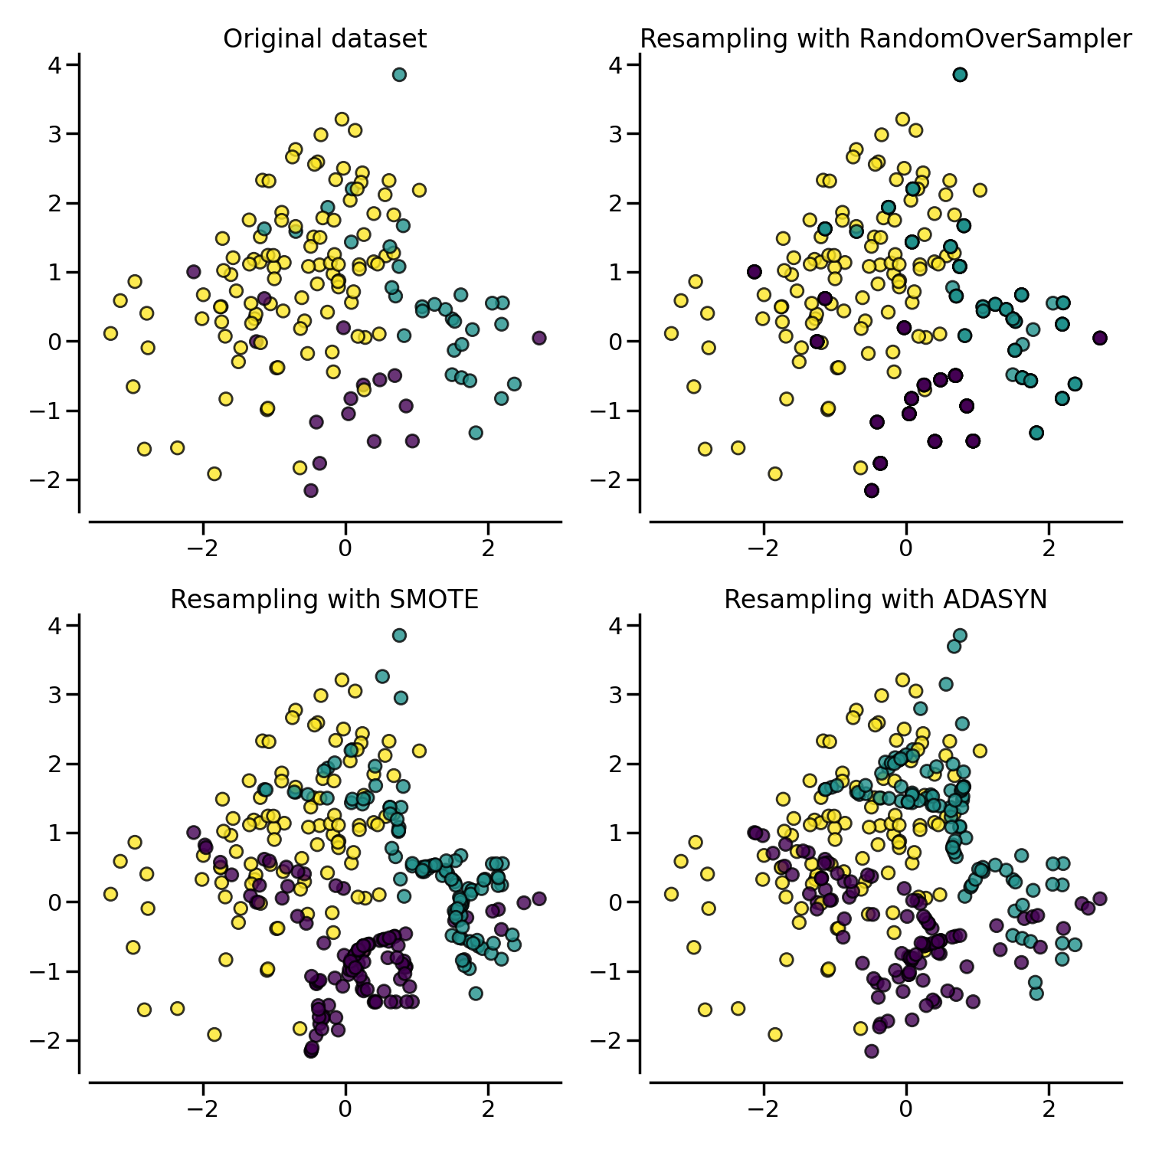
Balancing dataset
label 4: 144
label 2: 72
label 3: 12
label 1: 12
label 0: 11
label 4: 144
label 2: 144
label 3: 144
label 1: 144
label 0: 144

Slide 5
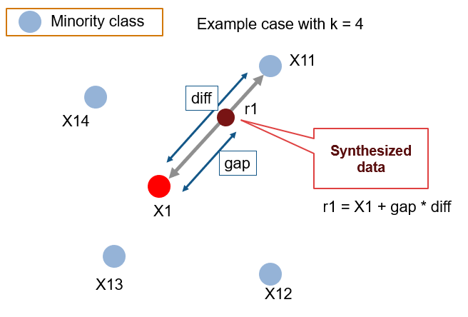
Balancing dataset
label 4: 144
label 2: 72
label 3: 12
label 1: 12
label 0: 11
label 4: 144
label 2: 144
label 3: 144
label 1: 144
label 0: 144

Slide 6
Final dataset
original data: (251, 50)
features: 25 peaks (Wave length, Amplitude)
[Y_max+1, Y_max-1, X_max+1, X_max-1, ... , X_max, Y_max]
Final data: (480, 50)
each label has 96 data
lable: (251, 1)
2 classfication: (0: normal), (1: abnormal)
5 classification: (0: normal), (1: Cin1), (2: Cin2), (3: Cin3), (4: worst)

Slide 7
CLASSIFICATION: Analyze
Model: XGBoost
Oversampling: SMOTE
Data(480, 50), Label(5 classification)
Overall accuracy: 92.10%
Accuracy of each label
Normal(0): 100%
CIN 1(1): 100%
CIN 2(2): 81%
CIN 3(3): 75%
Worst(4): 98%

Slide 8
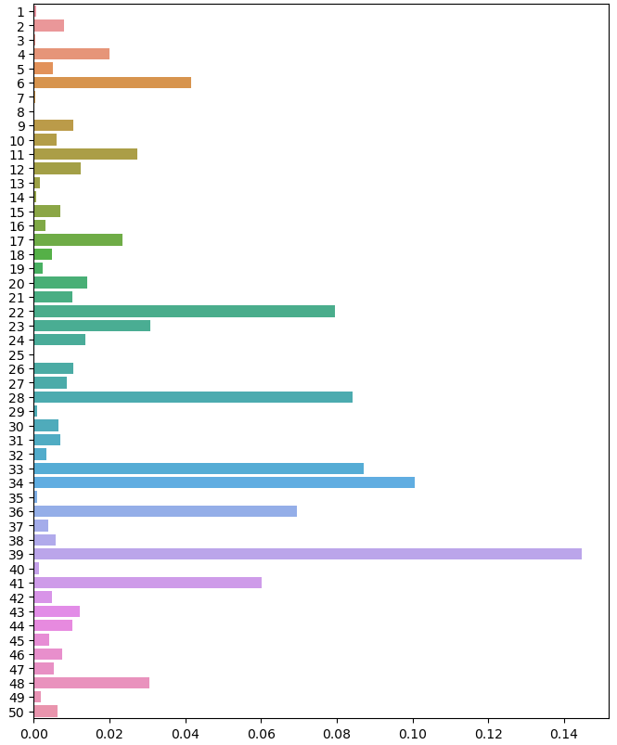
Parameters weight
Top 5
index 39: 14.47%
index 34: 10.08%
index 33: 8.70%
index 28: 8.42%
index 22: 7.94%

Slide 9
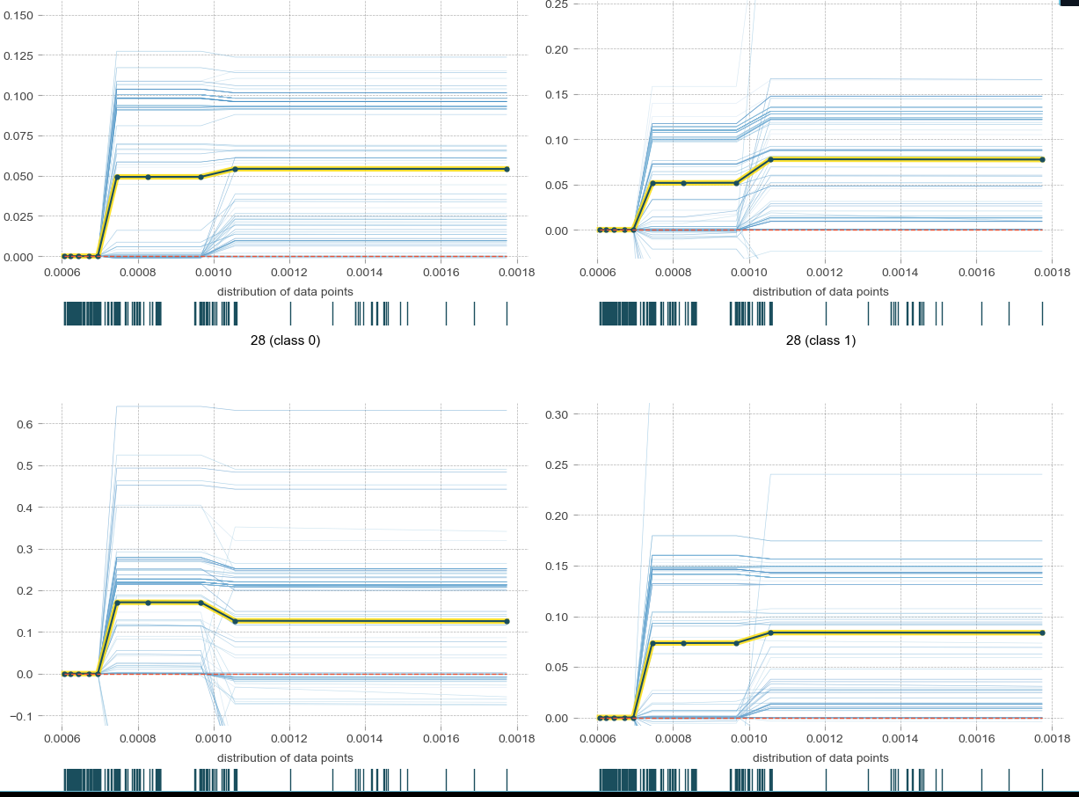
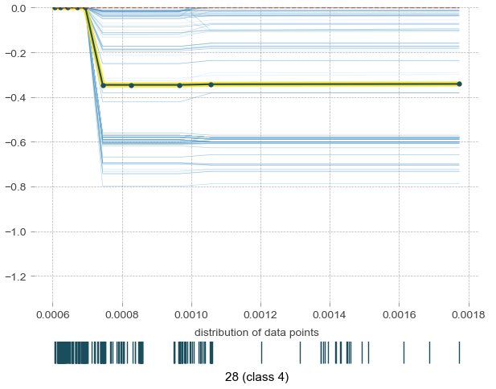
Isolate plot
Index: 28
can detect the ‘worst’ label

Slide 10
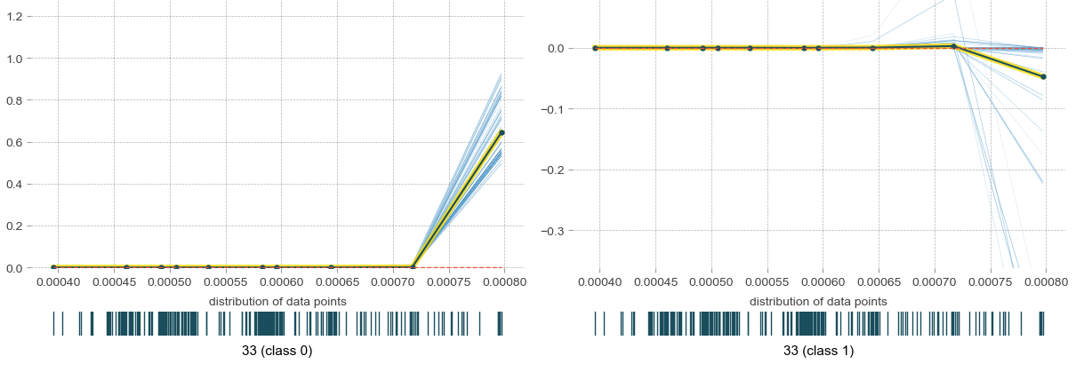
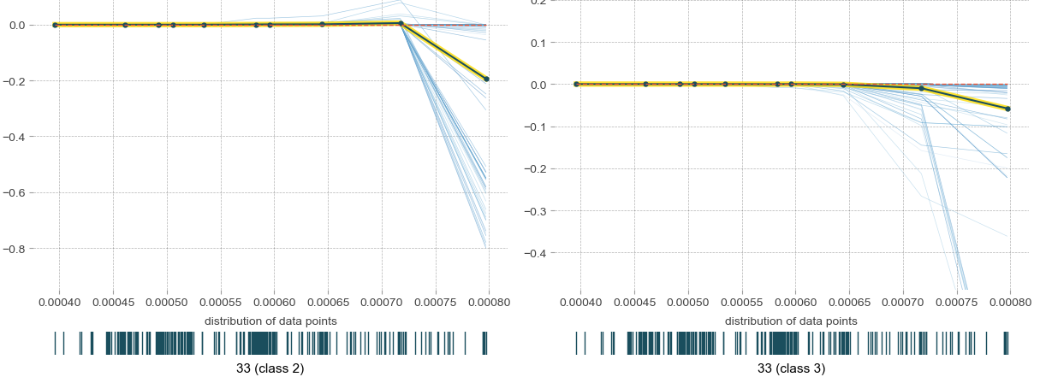
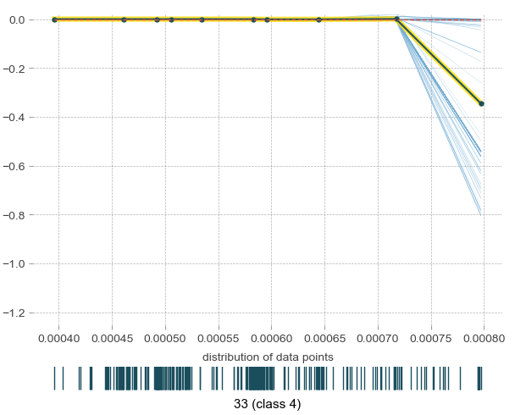
Isolate plot
Index: 33
can detect the ‘normal’ label

Slide 11
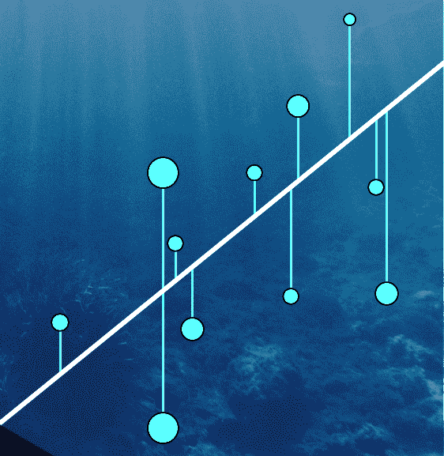
Regression: Random forest
Regression models the relationship between variables.
It assumes a linear relationship.
It aims to minimize the difference between observed and predicted values.
Parameters like slope and intercept are estimated.
Widely used in predictive modeling and understanding correlations.

Slide 12
regression: RESULTS
Root Mean Quared Error (RMSE)

